Slide 1

VALLURUPALLI NAGESWARA RAO VIGNANA JYOTHI INSTITUTE OF ENGINEERING AND TECHNOLOGY
Department of Computer Science and Engineering
MACHINE LEARNING
Dr. Kriti Ohri
Assistant Professor
Department of Computer Science and Engineering

Slide 2
Cross-Validation

Slide 3
Definitions of Train, Validation, and Test Datasets
Training Dataset: The sample of data used to fit the model.
Validation Dataset: The sample of data used to provide an unbiased evaluation of a model fit on the training dataset while tuning model hyperparameters. The evaluation becomes more biased as skill on the validation dataset is incorporated into the model configuration.
Test Dataset: The sample of data used to provide an unbiased evaluation of a final model fit on the training dataset.

Slide 4
Training set
The training set the largest corpus of your dataset that you reserve for training your model.
For a default, we recommend allocating 70% of your dataset to the training set.
Purpose: The training dataset is used to train the machine learning model. The model learns the patterns, relationships, and parameters from this data.
Usage: During training, the model adjusts its weights and biases to minimize the error between the predicted outputs and the actual outputs in this dataset.
Size: Typically, the largest portion of the data is allocated to the training set (e.g., 60-80% of the total data), as the model needs sufficient data to learn effectively.
Overfitting Risk: If the model fits too closely to the training data, it might overfit, meaning it performs well on the training data but poorly on unseen data.

Slide 5
Validation set
The validation set is a separate section of your dataset that you will use during training to get a sense of how well your model is doing on the data that is not being used in training.
During training, it is common to report validation metrics continually after each training epoch such as validation mAP or validation loss. You use these metrics to get a sense of when your model has hit the best performance it can reach on your validation set

Slide 6
Purpose: The validation dataset is used to tune the model's hyperparameters (e.g., learning rate, number of layers, regularization parameters) and to evaluate model performance during the training process.
Usage: After training on the training set, the model is evaluated on the validation set to see how well it generalizes to unseen data. The performance on this set guides decisions on hyperparameter adjustments and model selection.
Overfitting Risk: If the model or its hyperparameters are adjusted too frequently based on validation performance, the model may overfit to the validation set, leading to an overly optimistic assessment of its generalization ability.

Slide 7
Testing Data
After all of the training experiments have concluded, you probably have gotten a sense on how your model might do on the validation set. But it is important to remember that the validation set metrics may have influenced you during the creation of the model, and in this sense you might, as a designer, overfit the new model to the validation set.
Because the validation set is heavily used in model creation, it is important to hold back a completely separate stronghold of data - the test set. You can run evaluation metrics on the test set at the very end of your project, to get a sense of how well your model will do in production.
We recommend allocating 10% of your dataset to the test set.

Slide 8
Test Dataset
Purpose: The test dataset is used to provide an unbiased evaluation of the final model after it has been trained and validated. It is intended to simulate how the model will perform on real-world, unseen data.
Usage: The model is evaluated on the test set only once, after the final model has been chosen, to assess its true generalization performance.
Overfitting Risk: There is no risk of overfitting to the test set, as it should be used only once, after all model tuning is complete.

Slide 9
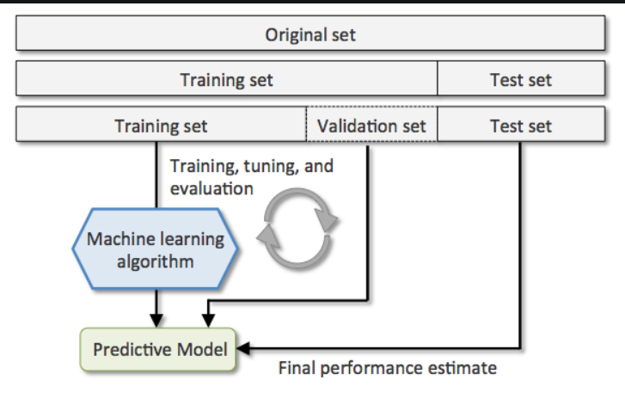
Train-Validate-Test

Slide 10
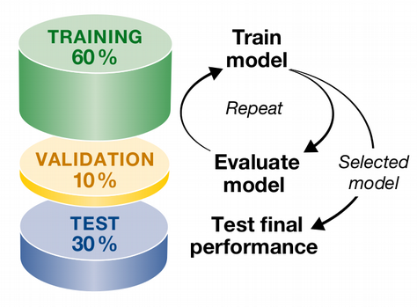
Train Validate Test

Slide 11
Ways of doing evaluation with limited dataset

Slide 12
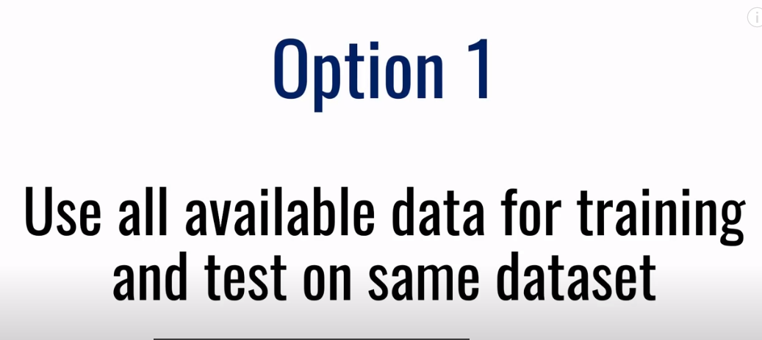
Not a good approach

Slide 13
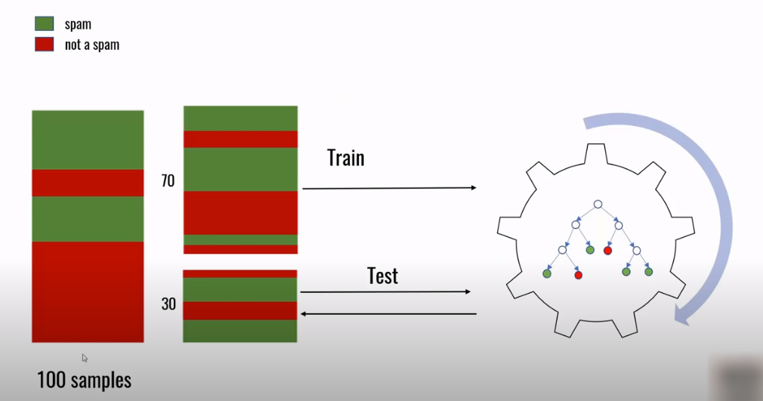
Option 2 (medium approach)

Slide 14
In option 2 : Size of training dataset will decrease and it may lead to overfitting.
Size of testing Data set also will get less, as you will try to maximize training data set, and having a small testing dataset is not preferred.
There is no mechanism of fine tuning the parameters of the model that is to say no model evaluation is being done.

Slide 15
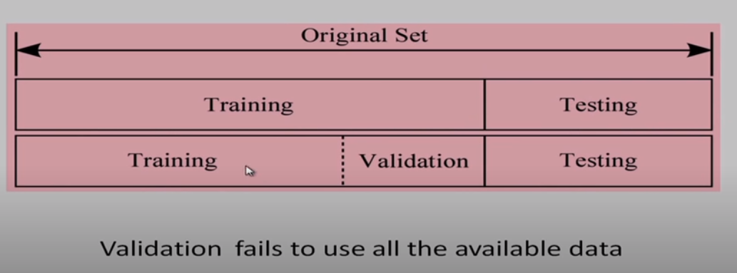
Option3-Validation Set

Slide 16
Validation is failing to use all the examples of training data set
So, we want to use all the examples for validation and for that we have a scheme called K fold cross validation. (option4-good approach)

Slide 17
Cross validation
For any model in Machine Learning, it is considered as a best practice if the model is tested with an independent data set. Normally, any prediction model works on a known data set which is also known as the training set.
But in a real-life scenario, the model will be tested for its efficiency and accuracy with an altogether different and unique data set. Under those circumstances, you’d want your model to be efficient enough or at least to be at par with the same efficiency that it shows for the training set. Basically this testing is known as cross-validation in Machine Learning so that it is fit to work with any model in the future.
We can also call it a technique for asserting how the statistical model generalizes to an independent data set. Now that we know what cross-validation stands for, let us try to understand cross-validation in simple terms.

Slide 18
The basic purpose of cross-validation is to assess how the model will perform with an unknown data set. For instance, you are trying to score a goal in an empty goal. It looks pretty easy, and you could even score from a considerable distance too. But the real test starts when there is a goalkeeper and a bunch of defenders. That’s why you need to get trained in a real match facing all the heat and still score the goal.
Similarly, a statistical model is trained in such a way that it excels in its efficiency with other unknown data sets using cross-validation.

Slide 19
Cross-validation is a technique in machine learning used to assess how well a model generalizes to an independent dataset, helping to prevent overfitting and provide a more accurate estimate of a model's performance on unseen data. It is particularly useful when the available data is limited, as it allows you to maximize the use of the data for both training and validation purposes.

Slide 20
Types Of Cross-Validation
There are two types of cross-validation techniques in Machine Learning.
Non-Exhaustive Cross-Validation – In this method, the original data set is not separated into all the possible permutations and combinations. Example: K-fold Cross-Validation, Holdout Method.
Exhaustive Cross-Validation – This method basically involves testing the model in all possible ways, it is done by dividing the original data set into training and validation sets. Example: Leave-p-out Cross-Validation, Leave-one-out Cross-validation.

Slide 21
Types of Cross Validation
Cross Validation
Non-exhaustive cross validation
Exhaustive cross validation
K fold Cross-Validation
Stratified K Fold Cross Validation
Leave-P-Out Cross-Validation

Slide 22
Non-exhaustive Methods
Non-exhaustive cross validation methods, as the name suggests do not compute all ways of splitting the original data. Let us go through the methods to get a clearer understanding. Eg. of Non exhaustive methods
K-fold Cross-Validation
Stratified K Fold Cross Validation

Slide 23
K-Fold Cross-Validation
In Machine Learning, there is never enough data to train the model. Even then, if we remove some part of the data, it poses a threat of overfitting the Machine Learning model. It is also possible that it may not recognize a dominant pattern if enough data is not provided for the training phase.
By reducing the data, we also face the risk of reduced accuracy due to the error induced by bias. To overcome this problem, we need a method that would provide ample data for training and some data for testing. K-fold Cross-validation does exactly that.

Slide 24
K-Fold Cross-Validation
K-fold cross-validation is a popular method for assessing the performance of machine learning models. It involves splitting the data into kkk subsets (or "folds"), training the model on k−1k-1k−1 folds, and testing it on the remaining fold. This process is repeated kkk times, with each fold used once as the test set. While k-fold cross-validation has many advantages, such as reducing overfitting and providing a more robust estimate of model performance, it also has some disadvantages:

Slide 25
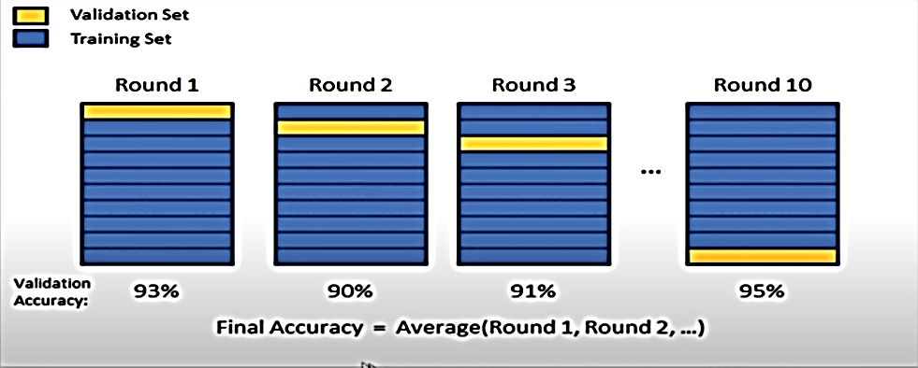
K Fold Cross Validation
Training Data Set
K=10, k rounds of learning

Slide 26
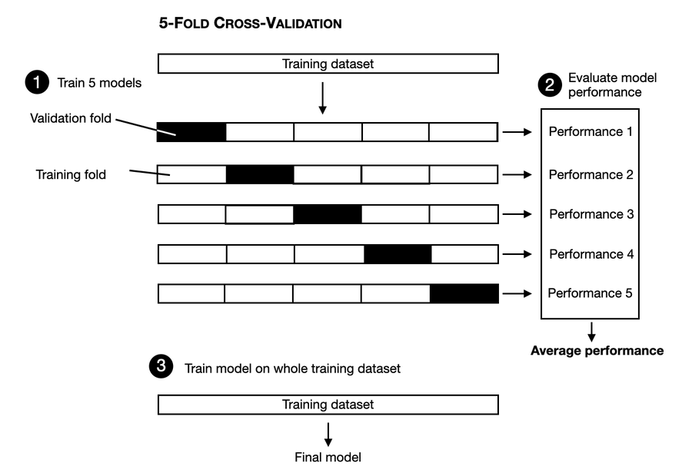

Slide 27
Steps for K Fold Validation
Randomly split your entire dataset into k number of folds (subsets)
For each fold in your dataset, build your model on k – 1 folds of the dataset. Then, test the model to check the effectiveness for kth fold
Repeat this until each of the k-folds has served as the test set
The average of your k recorded accuracy is called the cross-validation accuracy and will serve as your performance metric for the model.

Slide 28
Advantages of K fold validation:
Reduces variance in the performance metric by using multiple training/testing splits.
Makes efficient use of limited data.

Slide 29
Limitations Of K Cross-Validation
In an ideal situation, Cross-Validation will produce optimum results. But in case of inconsistent data, the results may vary drastically. It is quite uncertain what kind of data will be encountered by the model.
Predictive modeling often requires an evolution in terms of data, this can pretty much change the training and the validation sets drastically.
The results may vary depending upon the features of the data set. Let us say we make a predictive model to detect an ailment in a person and we train it with a specific set of population. It may vary with the general population causing inconsistency and reduced efficiency.

Slide 30
Limitations Of K Cross-Validation
Computationally Expensive
Increased Variance in Model Evaluation
Does Not Work Well with Time-Series Data
Stratification Issues in Imbalanced Datasets
Potential Overfitting to Validation Sets
Choice of k

Slide 31
Cross-Validation Applications
With the overpowering applications to prevent a Machine Learning model from Overfitting and Underfitting, there are several other applications of Cross-Validation listed below:
We can use it to compare the performances of a set of predictive modeling procedures.
Cross-Validation excels in the field of medical research.
It can be used in the meta-analysis since a lot of data analysts are already using cross-validation.

Slide 32
Stratified K Fold Cross Validation
Using K Fold on a classification problem can be tricky. Since we are randomly shuffling the data and then dividing it into folds, chances are we may get highly imbalanced folds which may cause our training to be biased. For example, let us somehow get a fold that has majority belonging to one class(say positive) and only a few as negative class. This will certainly ruin our training and to avoid this we make stratified folds using stratification.
Stratification is the process of rearranging the data so as to ensure that each fold is a good representative of the whole. For example, in a binary classification problem where each class comprises of 50% of the data, it is best to arrange the data such that in every fold, each class comprises of about half the instances.

Slide 33
Stratified K Fold Cross Validation
Process: Similar to k-fold cross-validation, but it ensures that each fold has the same proportion of classes as the original dataset. This is especially useful when dealing with imbalanced datasets.Example: In a binary classification problem with 90% of one class and 10% of another, stratified k-fold will ensure that each fold has the same 90:10 class distribution.

Slide 34
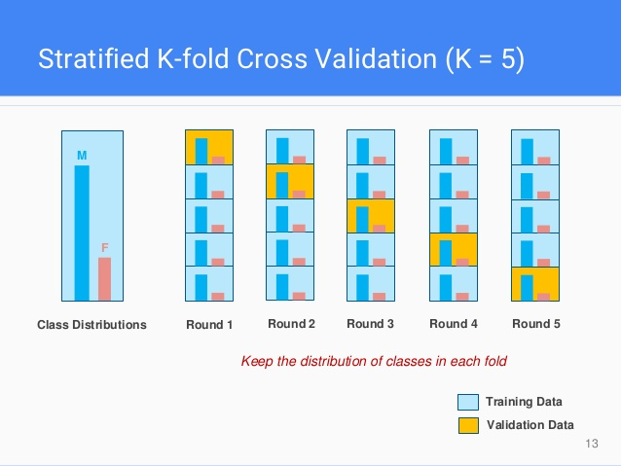

Slide 35
Exhaustive Methods
Exhaustive cross validation methods and test on all possible ways to divide the original sample into a training and a validation set.
Eg. Leave-P-Out Cross-Validation

Slide 36
Leave-P-Out Cross-Validation
Leave-P-Out Cross-Validation:
In this strategy, p observations are used for validation, and the remaining is used for training.
For a data set with n observations, n-p observations will be used for training, and p will be used for validation.
Since this method is exhaustive, it trains and tests on all possible combinations, and it can become computationally expensive for large values of p.
LPO for p=3

Slide 37
Leave-One-Out Cross-Validation (LOOCV):
Process: A special case of k-fold cross-validation where kkk is equal to the number of observations in the dataset. Each observation is used once as the validation data while the remaining n−1n-1n−1 observations are used for training.
Example: If you have 100 data points, the model is trained 100 times, each time leaving out one data point as the test set.

Slide 38
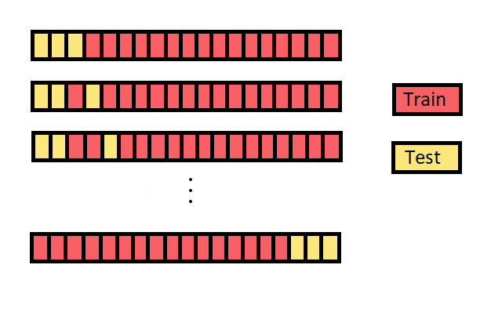
Leave-P-Out Cross-Validation
LPO for p=3

Slide 39
THANK YOU

